Slide 1
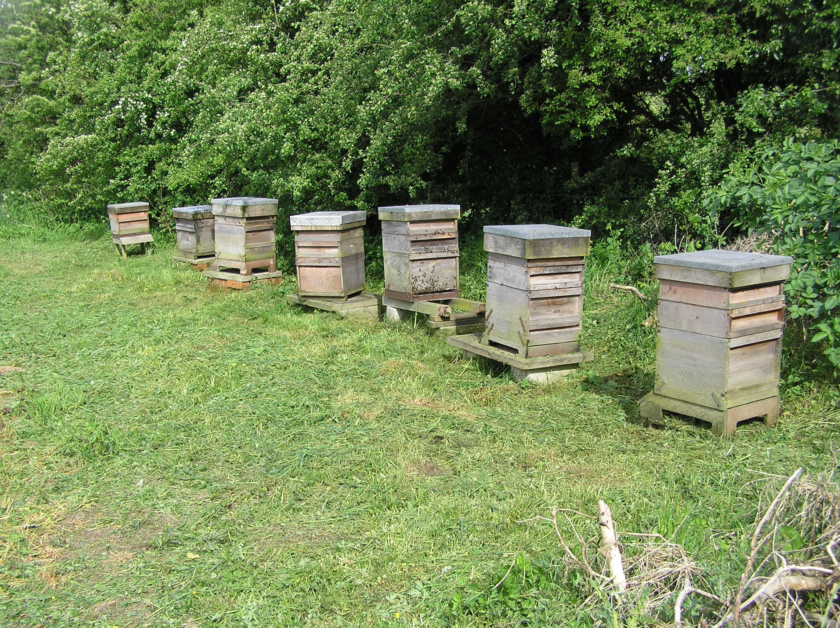
Conwy Beekeepers
Beginners Course
Session 2
The Honeybee Colony
Notes:
Tonight we will be looking at Hives, frames and equipment. First we’ll look at the options. Later we will all make up a frame, and I’ll demonstrate how to put together a brood box

Slide 2
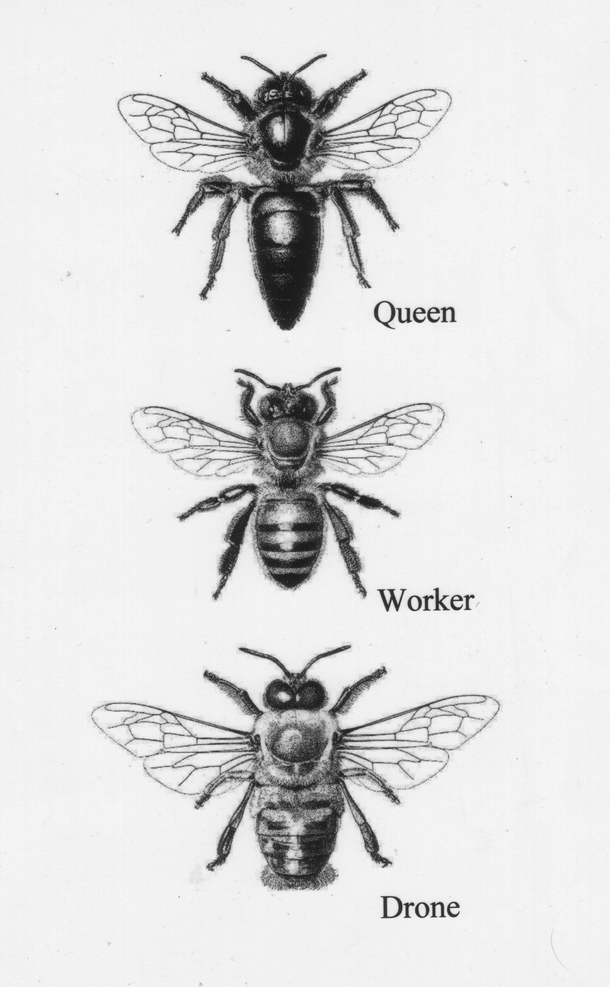
Identification of Worker, Queen and Drone

Slide 3
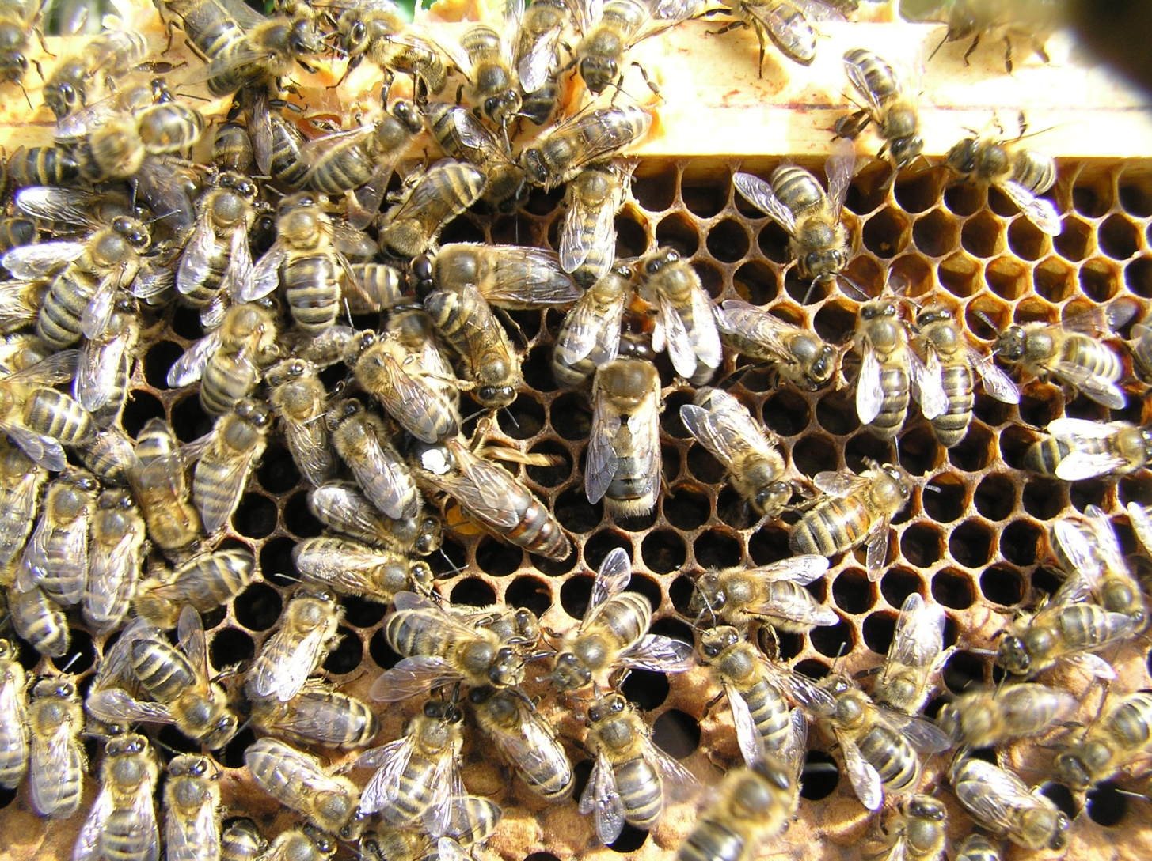
Identification of Worker, Queen and Drone

Slide 4
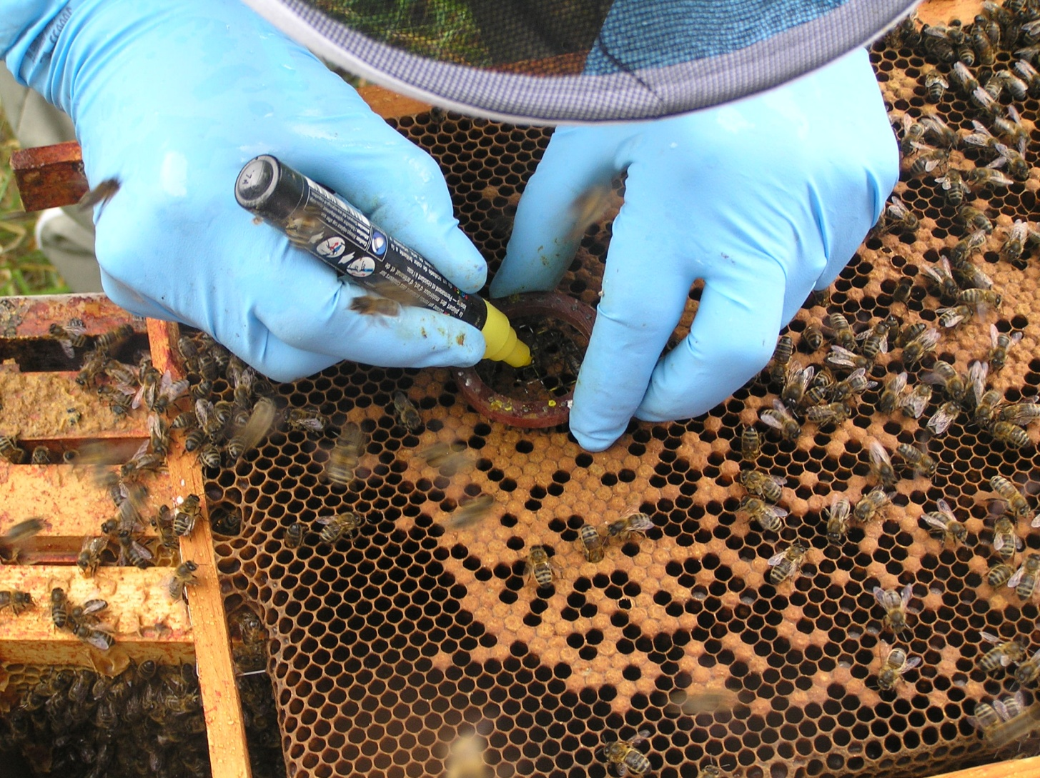
Marking the Queen

Slide 5
Typical colony population

Slide 6
The Colony
What maintains the correct balance in the colony?

Slide 7
The controlling influence
The queen produces a pheromone known as “Queen Substance”.
The amount of this queen substance produced depends on the age of the queen
Other factors which will have an influence on the colony:
  Time of year
  Weather
  Available forage

Slide 8
What we look for when inspecting our hives
Is the queen laying – not “Can we find the queen”
Do the bees have any disease?
Are there any drones?
Are the bees bringing in pollen?
Do the bees have plenty of food?
Do the bees have plenty of space?

Slide 9
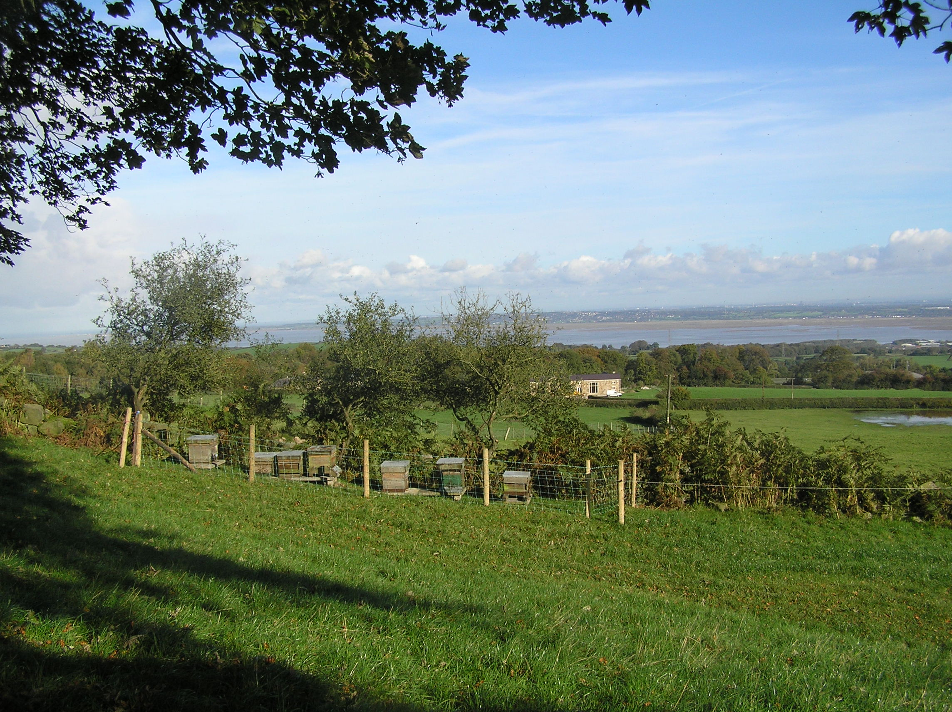
o
Break for tea or coffee
then we will look at the technique of opening and closing hives, and moving hives

Slide 10
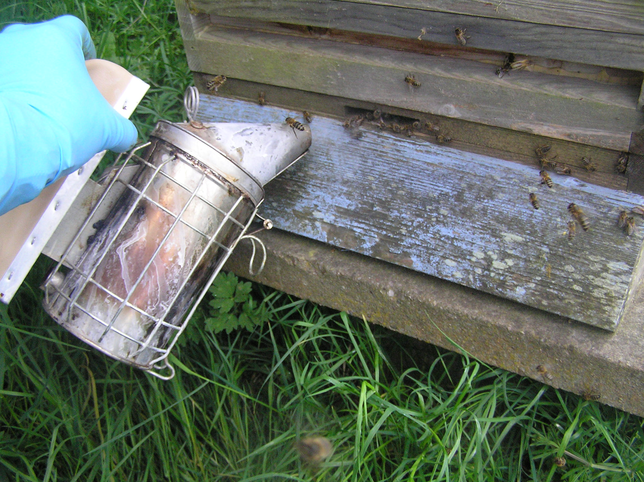

Slide 11
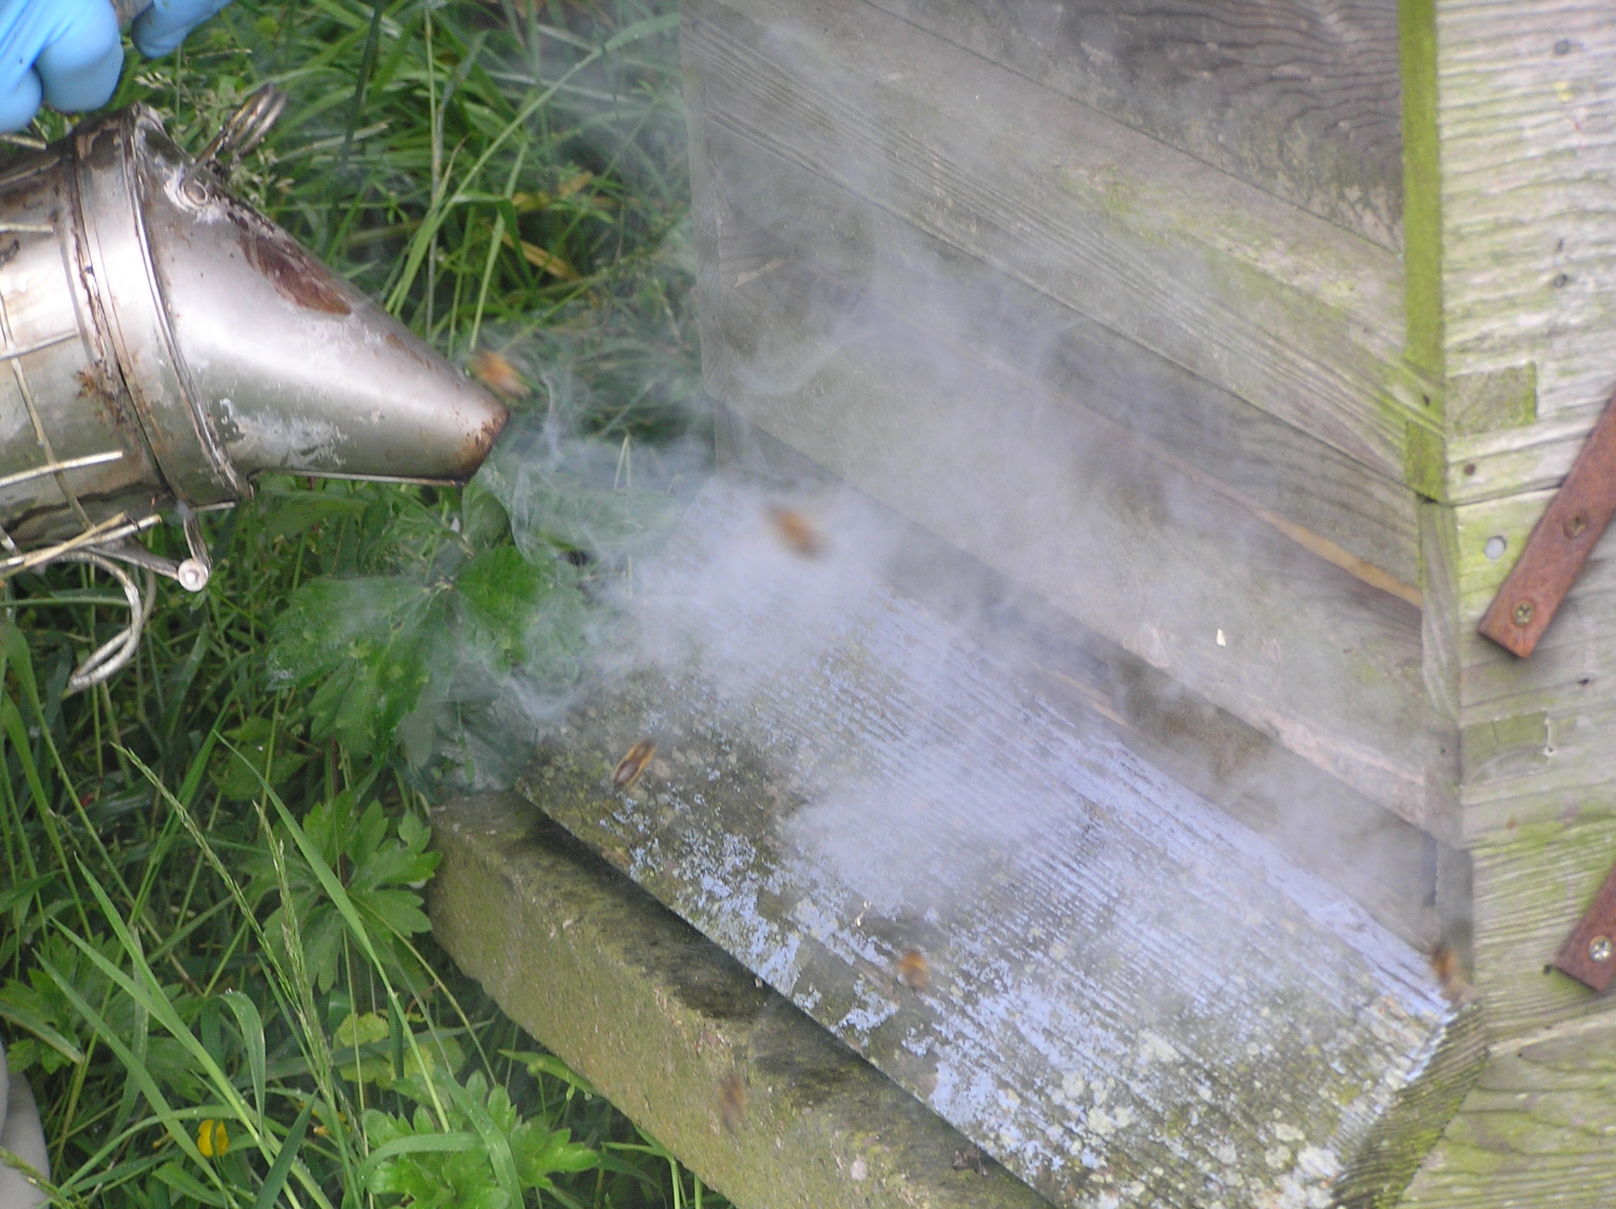

Slide 12
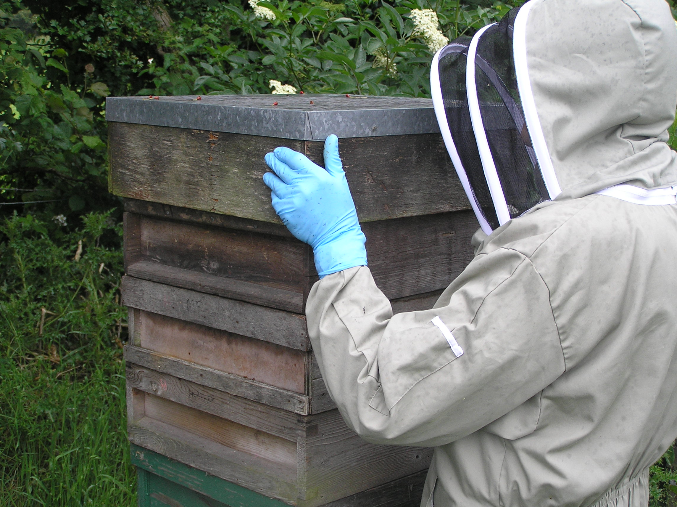

Slide 13
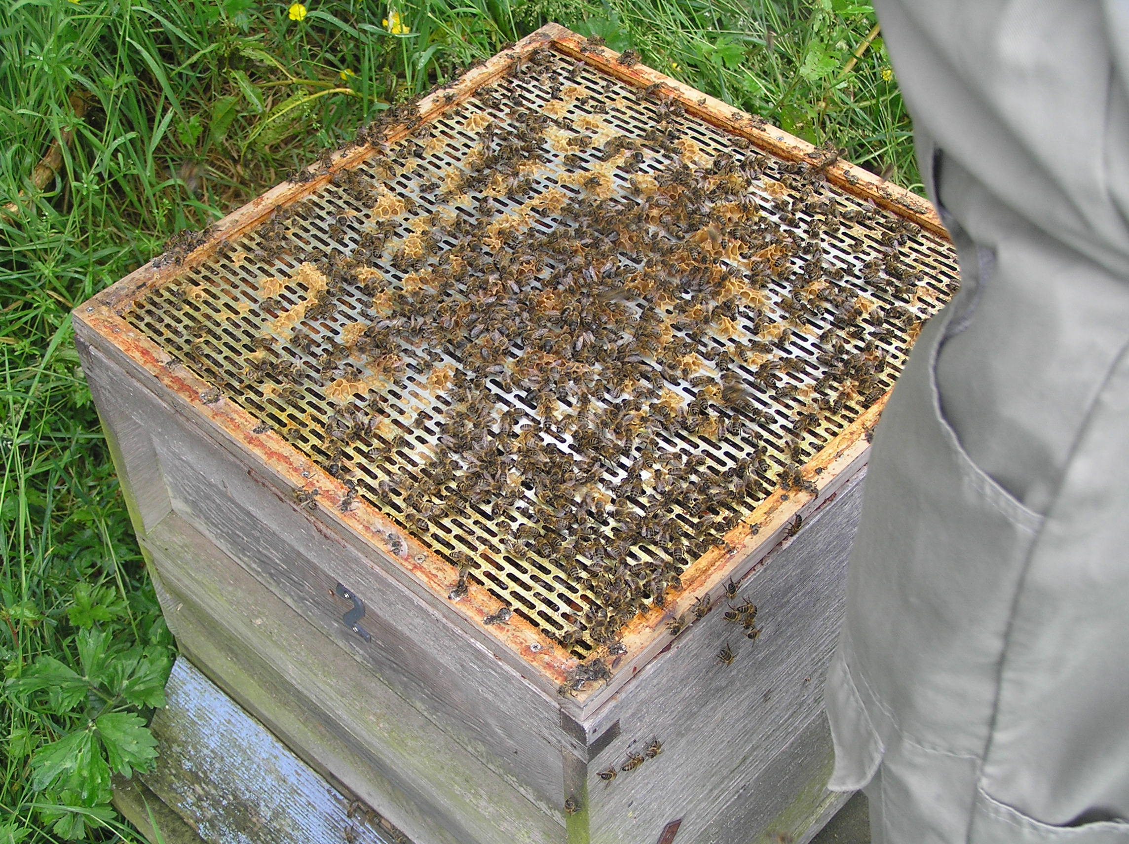

Slide 14
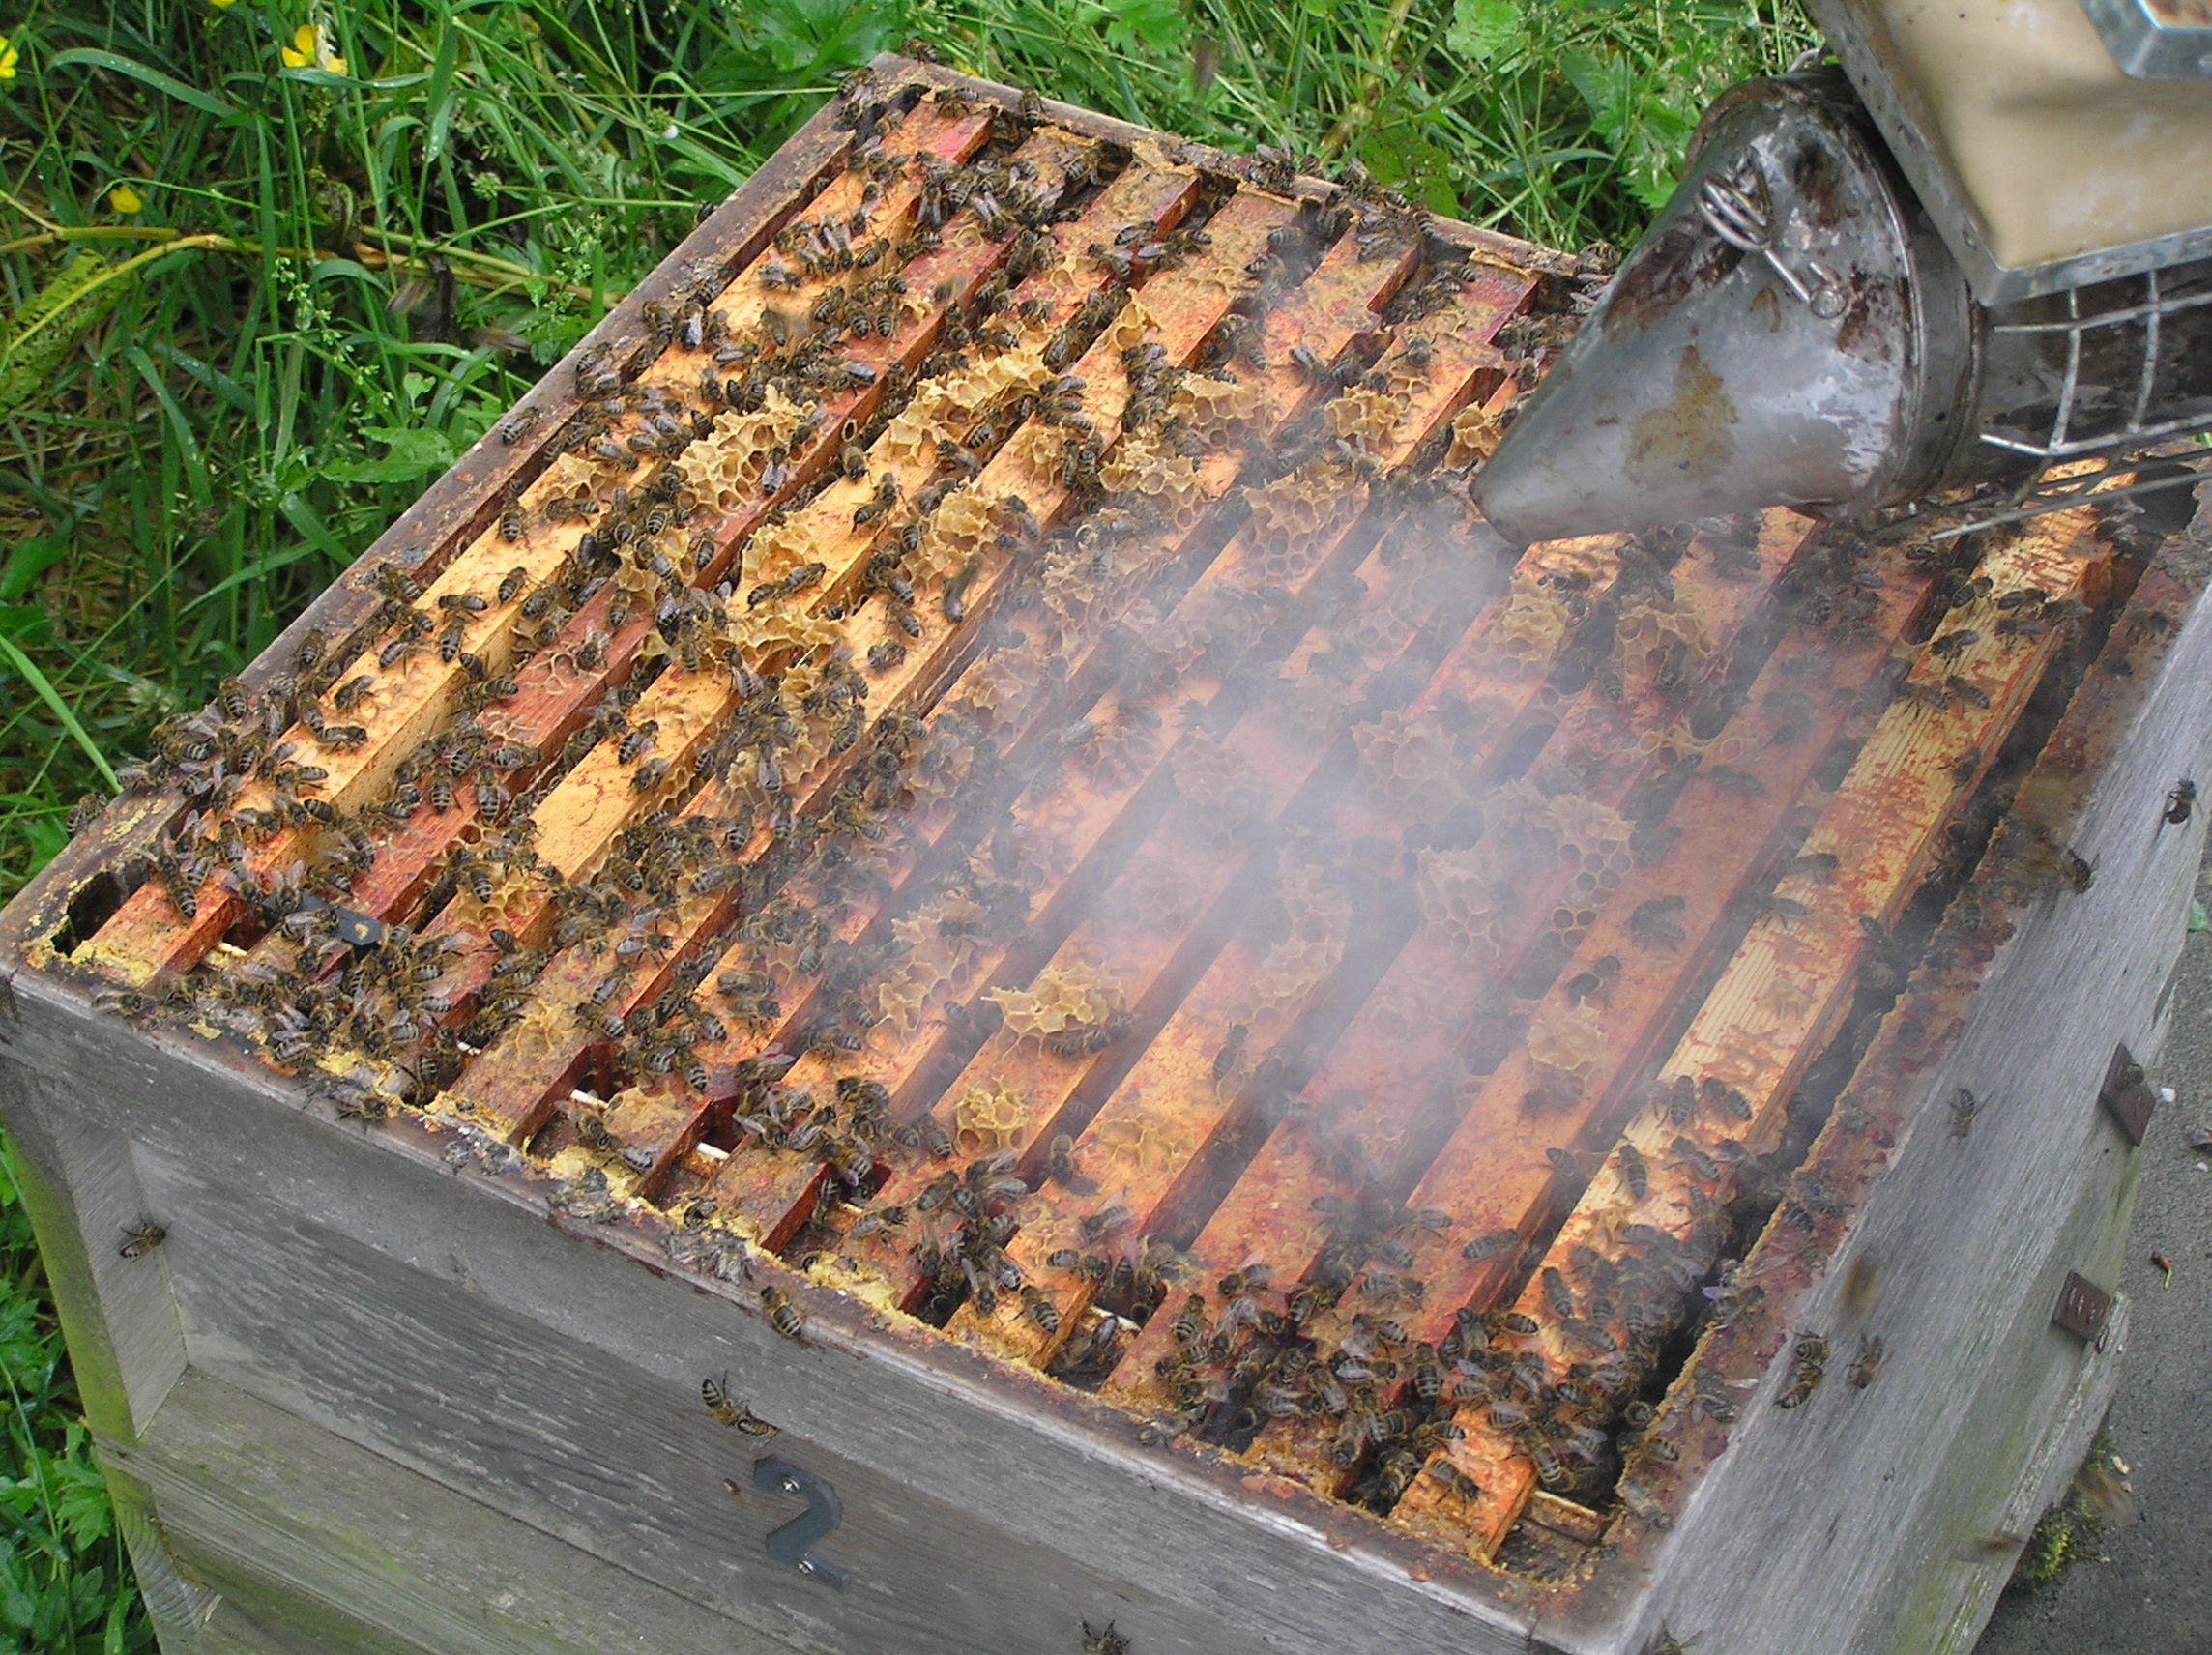

Slide 15
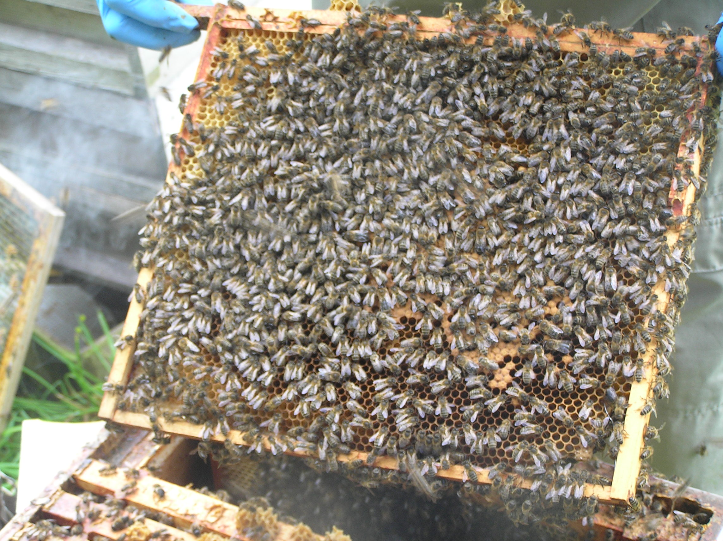

Slide 16
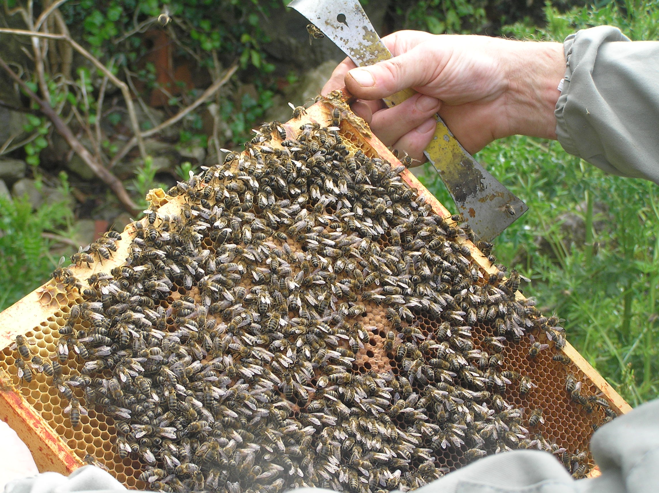

Slide 17
Moving Hives
The rule for moving hives is:
Less than 3 feet
More than 3 miles

Slide 18
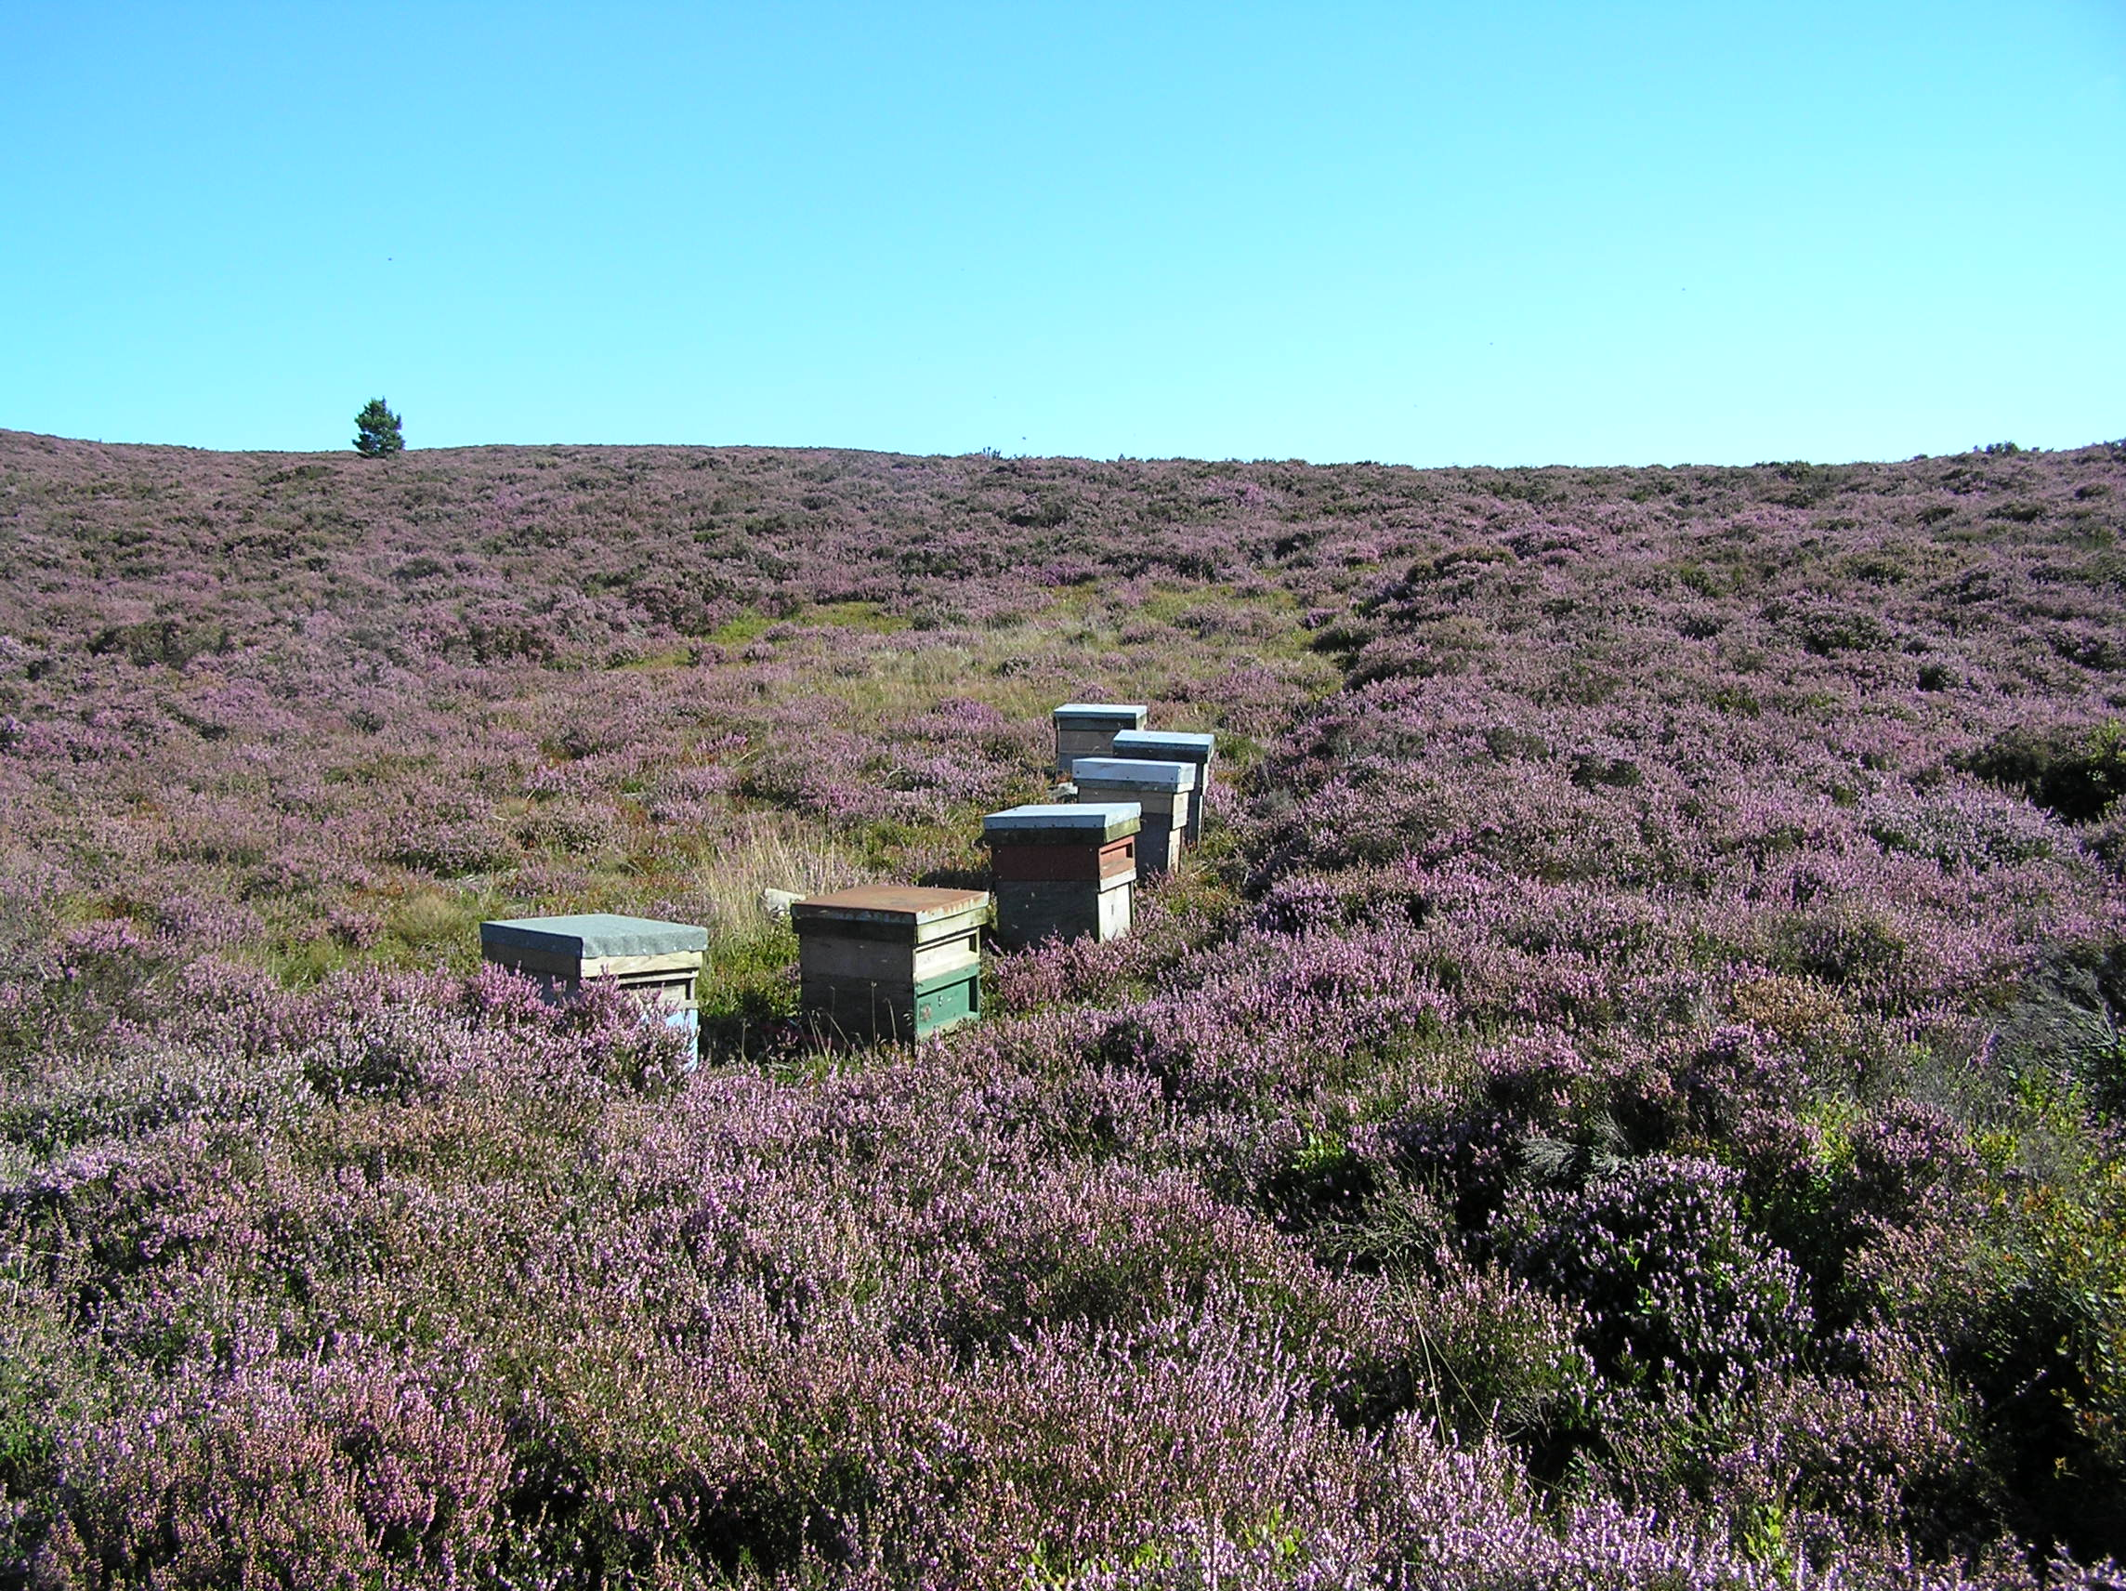

Slide 19
Preparing for transportation
The day before – remove crown board and replace with a ventilated screen.
Strap up the hive so that the whole thing is held together.
Replace the roof
Late in the evening (or very early in the morning) when no bees are flying, close up the entrance with a strip of foam rubber, and then remove the roof.

Slide 20
Moving the hive
Best to move in the early morning, before the sun is hot.
This is better than moving in the evening as the bees can fly as soon as they reach their destination.
Try not to shake the bees up to much!
If the journey is long, you may need to pour some water into the top to kep them cool

Slide 21
When you get to the new site
Set up the hives.
Then remove the foam from the entrance and replace the roof – IN THAT ORDER
Retreat !!!!

Slide 22
Returning to the old site
This is done exactly the same but –
  If returning within 3 weeks, put the hives in the exact position in the apiary as they were before the move
  If later than 3 weeks they can go anywhere.

Slide 23
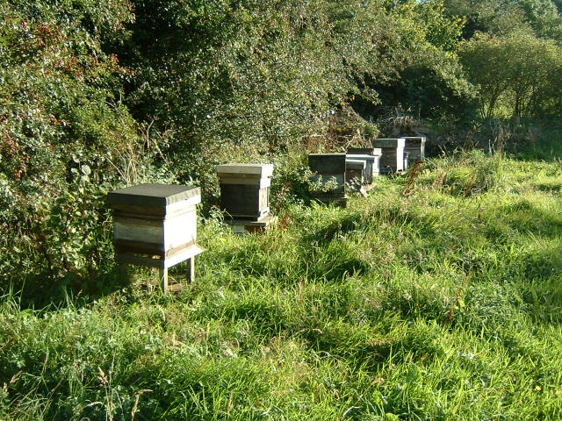
That’s it for tonight
Don’t forget to pick up your homework

